Slide 1
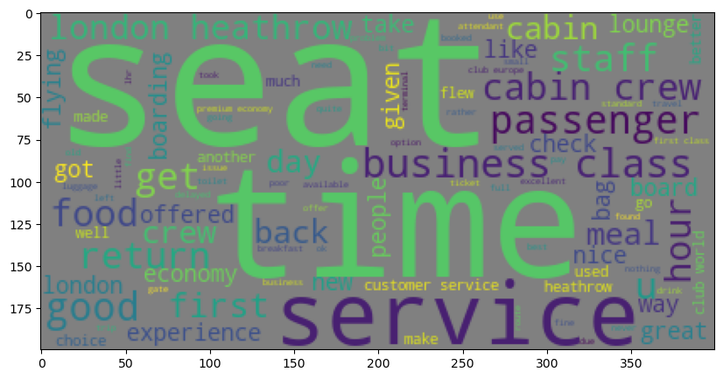
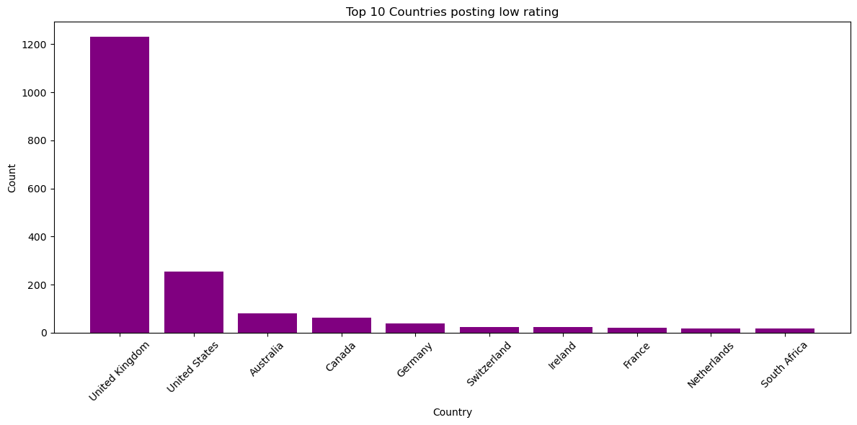
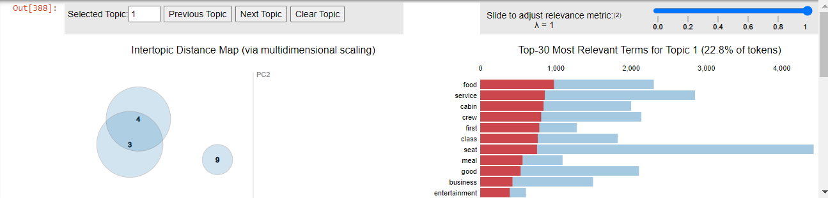
BRITISH AIRWAYS INSIGHTS TEAM
Analysis of reviews from SKYTRAX
TOTAL of 3654 reviews collected
Words that most commonly appear in the reviews corpus
Average rating= 4.7/10
Top 10 countries that has given the lowest ratings
The entire reviews discusses on 10 topics, please refer the notebook for interactive visualizations.

Slide 2
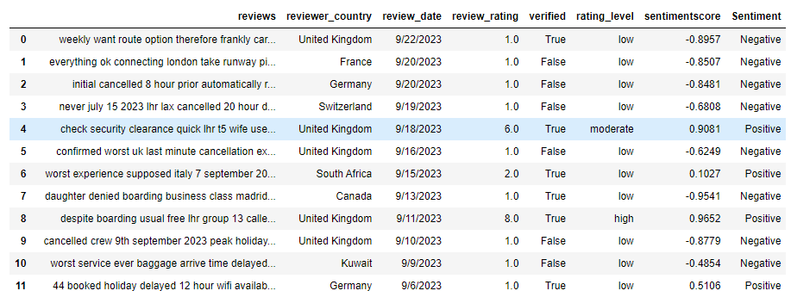
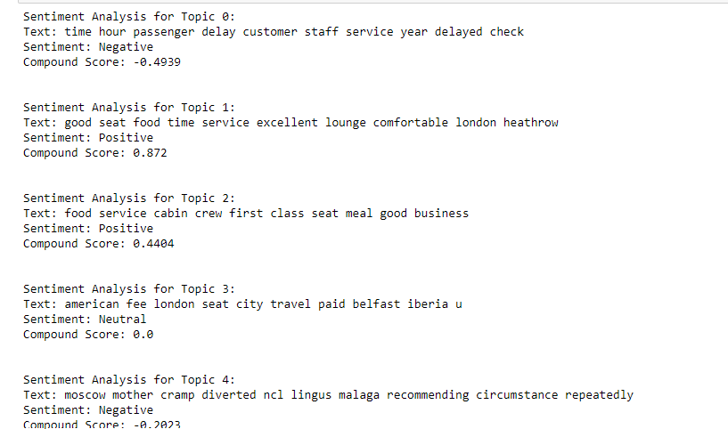
Sentiment analysis for every review to perform detailed analysis.
Sentiment analysis on topics to have a broader sense.

